Slide 1
Threads

Slide 2
LECTURE OBJECTIVES
To introduce the notion of a thread—a fundamental unit of CPU utilization that forms the basis of multithreaded computer systems.
To discuss the APIs for the Pthreads, Windows, and Java thread libraries.
To explore several strategies that provide implicit threading.
To examine issues related to multithreaded programming.
To cover operating system support for threads in Windows and Linux.

Slide 3
Threads
Overview
Multithreading Models
Threading Issues
Pthreads
Solaris 2 Threads
Windows 2000 Threads
Linux Threads
Java Threads

Slide 4
Overview
Despite of the fact that a thread must execute in process, the process and its associated threads are different concept.
Processes are used to group resources together and threads are the entities scheduled for execution on the CPU.
A thread is a single sequence stream within in a process.
Because threads have some of the properties of processes, they are sometimes called lightweight processes.

Slide 5
Processes Vs Threads
Processes are typically independent, while threads exist as subsets of a process
processes carry considerably more state information than threads, whereas multiple threads within a process share process state as well as memory and other resources
processes have separate address spaces, whereas threads share their address space
processes interact only through system-provided inter-process communication mechanisms, whereas threads communicate directly

Slide 6
Process
An executing instance of a program is called a process.
Some operating systems use the term ‘task‘ to refer to a program that is being executed.
A process is always stored in the main memory also termed as the primary memory or random access memory.
Therefore, a process is termed as an active entity. It disappears if the machine is rebooted.

Slide 7
Process
Several process may be associated with a same program.
On a multiprocessor system, multiple processes can be executed in parallel.
On a uni-processor system, though true parallelism is not achieved, a process scheduling algorithm is applied and the processor is scheduled to execute each process one at a time yielding an illusion of concurrency.
Example: Executing multiple instances of the ‘Calculator’ program. Each of the instances are termed as a process.

Slide 8
Thread
A thread is a subset of the process.
It is termed as a ‘lightweight process’, since it is similar to a real process but executes within the context of a process and shares the same resources allotted to the process by the kernel.
Usually, a process has only one thread of control – one set of machine instructions executing at a time.
A process may also be made up of multiple threads of execution that execute instructions concurrently.

Slide 9
Threads
Multiple threads of control can exploit the true parallelism possible on multiprocessor systems.
On a uni-processor system, a thread scheduling algorithm is applied and the processor is scheduled to run each thread one at a time.
All the threads running within a process share the same address space, file descriptor, stack and other process related attributes.
Since the threads of a process share the same memory, synchronizing the access to the shared data within the process gains unprecedented importance.

Slide 10
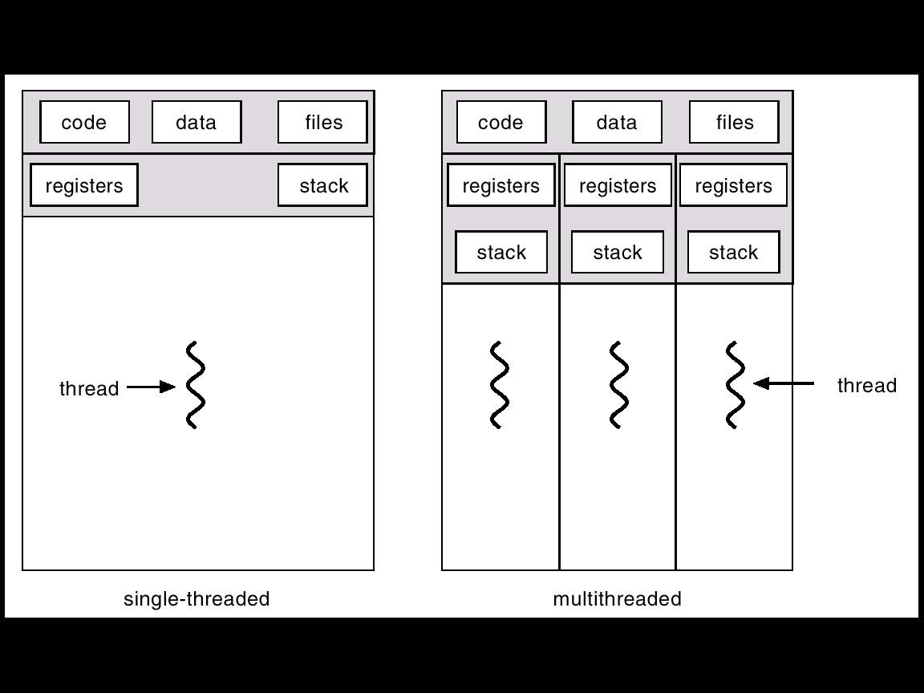
Single and Multithreaded Processes

Slide 11
Benefits
Less Response Times.
Resource Sharing- An advantage of using multiple threads over using separate processes is that the former share a single address space, all open files, and other resources.
Utilization of Multiprocessor Architectures. Multiple threads are useful in a multiprocessor system where threads run concurrently on separate processors

Slide 12
User Threads
Run in User mode and are Limited to performing certain tasks
Thread management done by user-level threads library
Examples
- POSIX Pthreads
- Mach C-threads
- Solaris threads

Slide 13
Kernel Threads
Supported by the Kernel – Have no limitations in accessing hardware and allocation of resources
Examples
- Windows 95/98/NT/2000
- Solaris
- Tru64 UNIX
- BeOS
- Linux

Slide 14
Multithreading Models
Multithreading allows multiple threads to exist within the context of a single process.
These threads share the process' resources but are able to execute independently. The threaded programming model provides developers with a useful abstraction of concurrent execution.
The models are;
- Many-to-One
- One-to-One
- Many-to-Many

Slide 15
Advantages of multithreading
Responsiveness: multithreading can allow an application to remain responsive to input. In a one-thread program, if the main execution thread blocks on a long-running task, the entire application can appear to freeze
Faster execution: this advantage of a multithreaded program allows it to operate faster on computer systems that have multiple CPUs or one or more multi core processor or across a cluster of machines, because the threads of the program naturally lend themselves to parallel execution, assuming sufficient independence
Lower resource consumption

Slide 16
Advantages of multithreading
Lower resource consumption: using threads, an application can serve multiple clients concurrently using fewer resources than it would need when using multiple process copies of itself.
Better system utilization: as an example, a file system using multiple threads can achieve higher throughput and lower latency since data in a faster medium can be retrieved by one thread while another thread retrieves data from a slower medium (such as external storage) with neither thread waiting for the other to finish.

Slide 17
Advantages of multithreading
Simplified sharing and communication: unlike processes, which require a message passing or shared memory mechanism to perform inter-process communication (IPC), threads can communicate through data, code and files they already share.
Parallelization: applications looking to use multicore or multi-CPU systems can use multithreading to split data and tasks into parallel subtasks and let the underlying architecture manage how the threads run, either concurrently on one core or in parallel on multiple cores

Slide 18
Multithreading Models: Many-to-One
In the many-to-one model, many user-level threads are all mapped onto a single kernel thread.
Thread management is handled by the thread library in user space, which is very efficient.
However, if a blocking system call is made, then the entire process blocks, even if the other user threads would otherwise be able to continue.
Because a single kernel thread can operate only on a single CPU, the many-to-one model does not allow individual processes to be split across multiple CPUs.

Slide 19
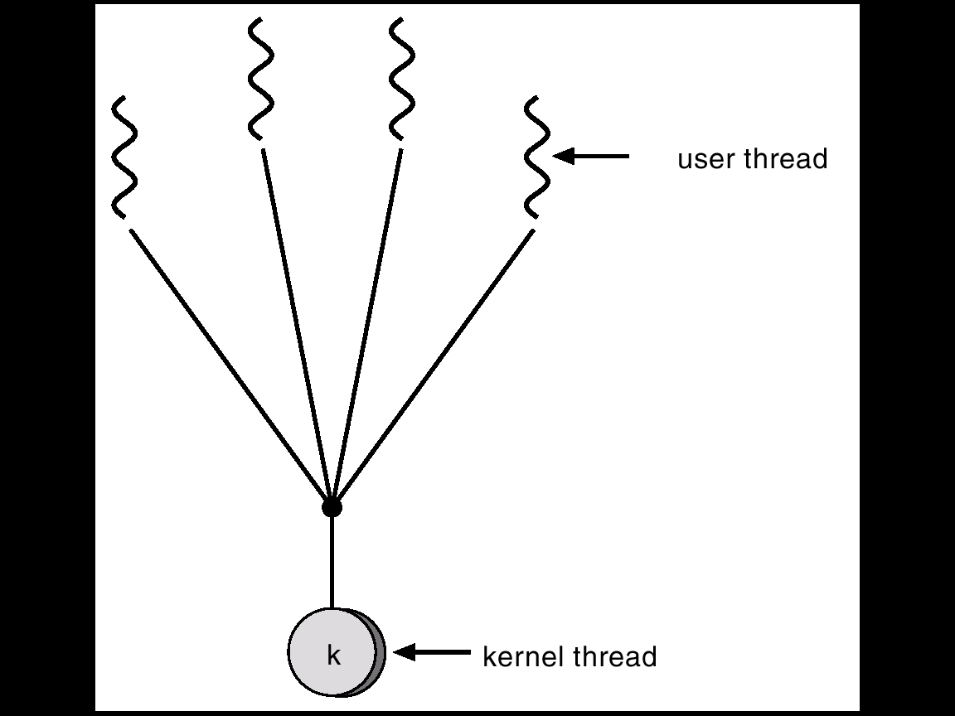
Many-to-One Model

Slide 20
One-to-One
The one-to-one model creates a separate kernel thread to handle each user thread.
One-to-one model overcomes the problems listed above involving blocking system calls and the splitting of processes across multiple CPUs.
However the overhead of managing the one-to-one model is more significant, involving more overhead and slowing down the system.
Most implementations of this model place a limit on how many threads can be created.
Linux and Windows from 95 to XP implement the one-to-one model for threads.

Slide 21
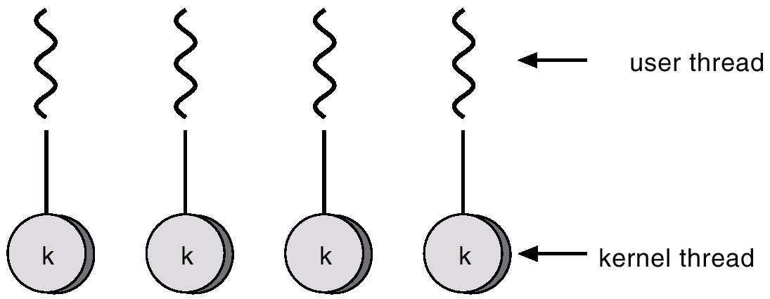
One-to-one Model

Slide 22
Many-to-Many Model
The many-to-many model multiplexes any number of user threads onto an equal or smaller number of kernel threads, combining the best features of the one-to-one and many-to-one models.
Users have no restrictions on the number of threads created.
Blocking kernel system calls do not block the entire process.
Processes can be split across multiple processors.
Individual processes may be allocated variable numbers of kernel threads, depending on the number of CPUs present and other factors.
Solaris 2 and Windows NT/2000 with the ThreadFiber package.

Slide 23
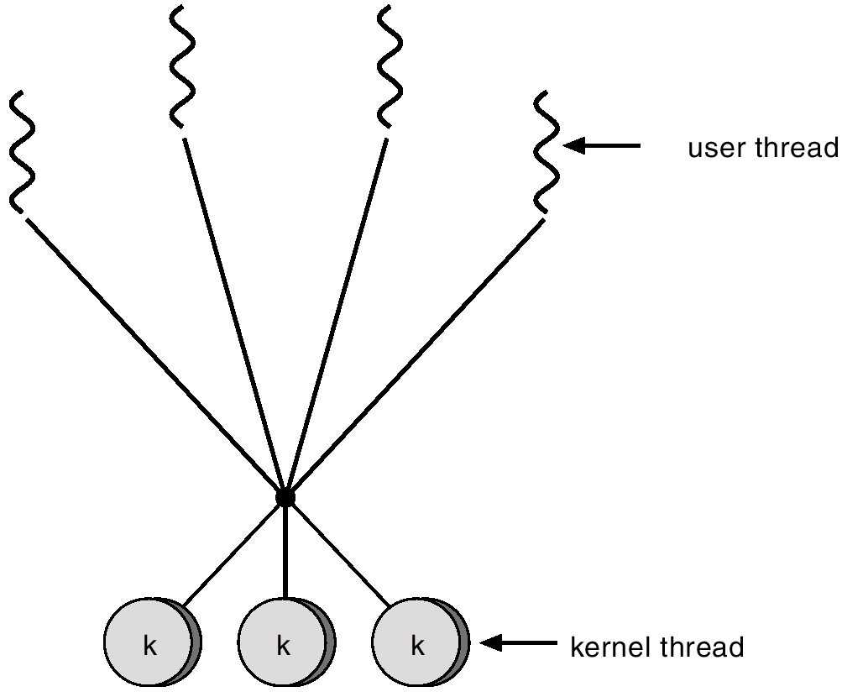
Many-to-Many Model

Slide 24
Thread issues
There are a variety of issues to consider with multithreaded programming
Semantics of fork() and exec() system calls
Thread cancellation
Asynchronous or deferred
Signal handling
Synchronous and asynchronous
Thread pooling
Thread-specific data
Create facility needed for data private to thread

Slide 25
Semantics of fork() and exec()
Recall that when fork() is called, a separate, duplicate process is created
How should fork() behave in a multithreaded program?
Should all threads be duplicated?
Should only the thread that made the call to fork() be duplicated?
In some systems, different versions of fork() exist depending on the desired behavior
Some UNIX systems have fork1() and forkall()
fork1() only duplicates the calling thread forkall() duplicates all of the threads in a process

Slide 26
Semantics of fork() and exec()
In a POSIX-compliant system, fork() behaves the same as fork1()
The exec() system call continues to behave as expected
Replaces the entire process that called it, including all threads
If planning to call exec()after fork(), then there is no need to duplicate all of the threads in the calling process
All threads in the child process will be terminated when exec() is called.
Use fork1(), rather than forkall() if using in conjunction with exec().

Slide 27
Thread Cancellation
Thread cancellation is the act of terminating a thread before it has completed
Example - clicking the stop button on your web browser will stop the thread that is rendering the web page
The thread to be cancelled is called the target thread
Threads can be cancelled in a couple of ways
Asynchronous cancellation terminates the target thread immediately. Thread may be in the middle of writing data ... not so good.
Deferred cancellation allows the target thread to periodically check if it should be cancelled. Allows thread to terminate itself in an orderly fashion.

Slide 28
Signal handling
Signals are used in UNIX systems to notify a process that a particular event has occurred
CTRL-C is an example of an asynchronous signal that might be sent to a process.
An asynchronous signal is one that is generated from outside the process that receives it
Divide by 0 is an example of a synchronous signal that might be sent to a process
A synchronous signal is delivered to the same process that caused the signal to occur.
All signals follow the same basic pattern:
A signal is generated by particular event.
The signal is delivered to a process.
The signal is handled by a signal handler.

Slide 29
Thread pools
In applications where threads are repeatedly being created/destroyed thread pools might provide a performance benefit.
Example: A server that spawns a new thread each time a client connects to the system and discards that thread when the client disconnects
A thread pool is a group of threads that have been pre-created and are available to do work as needed
Threads may be created when the process starts
A thread may be kept in a queue until it is needed
After a thread finishes, it is placed back into a queue until it is needed again

Slide 30
Thread specific data
Thread-specific data in some applications it may be useful for each thread to have its own copy of data
May also be referred to as Thread-local storage or Thread-static variables
The errno variable is thread-specific

Slide 31
Pthreads
The POSIX standard ( IEEE 1003.1c ) defines the specification for pThreads, not the implementation.
pThreads are available on Solaris, Linux, Mac OSX, Tru64, and via public domain shareware for Windows.
Global variables are shared amongst all threads.
One thread can wait for the others to rejoin before continuing.
pThreads begin execution in a specified function, in this example the runner( ) function:
Common in UNIX operating systems.

Slide 32
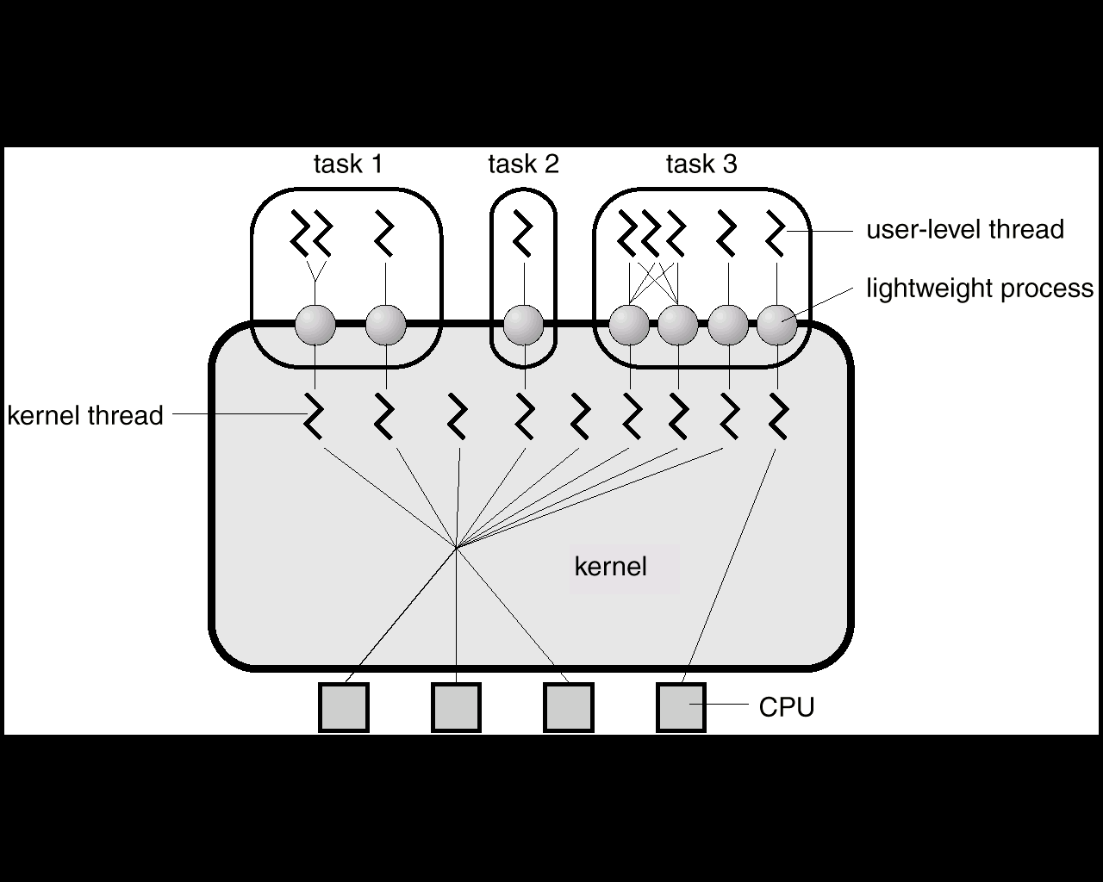
Solaris 2 Threads

Slide 33
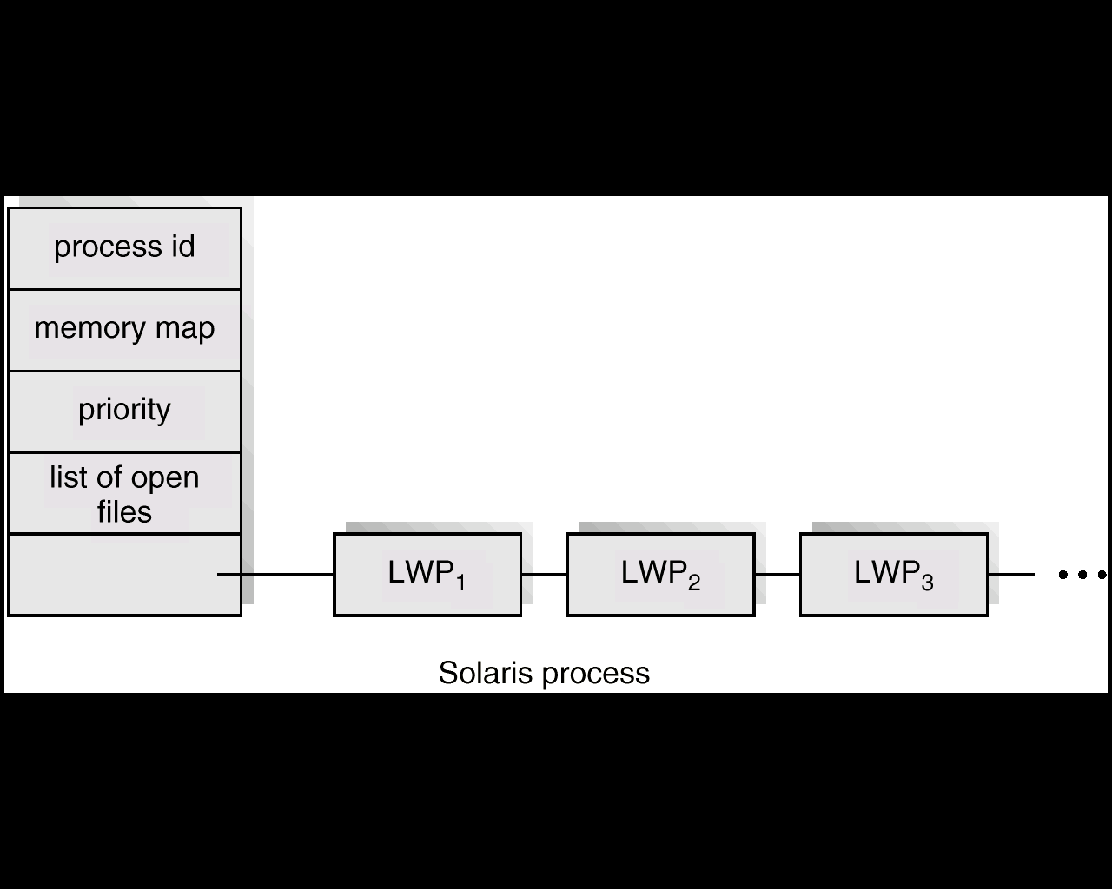
Solaris Process

Slide 34
Windows 2000 Threads
Implements the one-to-one mapping.
Each thread contains
- a thread id
- register set
- separate user and kernel stacks
- private data storage area

Slide 35
Linux Threads
Linux refers to them as tasks rather than threads.
Thread creation is done through clone() system call.
Clone() allows a child task to share the address space of the parent task (process)

Slide 36
Java Threads
Java threads may be created by:
Extending Thread class
Implementing the Runnable interface
Java threads are managed by the JVM.

Slide 37
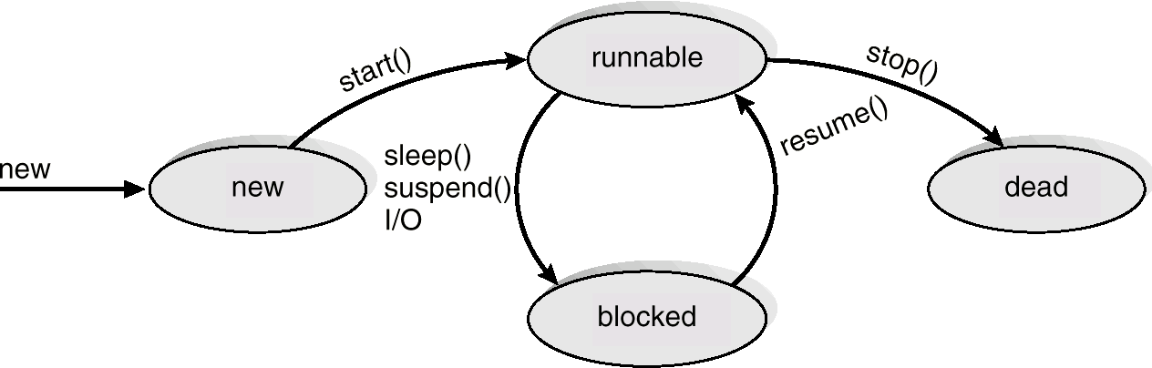
Java Thread States

Slide 38
Good programs to multithread:
Programs with multiple independent tasks (debugger needs to run and monitor program, keep its GUI active, and display an interactive data inspector and dynamic call grapher)
Server which needs to process multiple requests simultaneously
Repetitive numerical tasks — break large problem, such as weather prediction, down into small pieces and assign each piece to a separate thread

Slide 39
Programs difficult to multithread
Programs that don’t require any multiprocessing (99% of all programs)
Programs that require multiple processes (maybe one needs to run as root)

Slide 40
Example: Pthreads (C-Programming)
#include <pthread.h>
#include <stdio.h>
#define NUM_THREADS 5
void *PrintHello(void *threadid)
{ long tid;
tid = (long)threadid;
printf("Hello World! It's me, thread #%ld!\n", tid); pthread_exit(NULL);
}
int main (int argc, char *argv[])
{ pthread_t threads[NUM_THREADS];
int rc; long t;
for(t=0; t<NUM_THREADS; t++)
{ printf("In main: creating thread %ld\n", t);
rc = pthread_create(&threads[t], NULL, PrintHello, (void *)t);
if (rc){ printf("ERROR; return code from pthread_create() is %d\n", rc);
exit(-1); }
}
/* Last thing that main() should do */
pthread_exit(NULL); })

Slide 41
Output of program
In main: creating thread 0
In main: creating thread 1
Hello World! It's me, thread #0!
In main: creating thread 2
Hello World! It's me, thread #1!
Hello World! It's me, thread #2!
In main: creating thread 3
In main: creating thread 4
Hello World! It's me, thread #3!
Hello World! It's me, thread #4!

Slide 42
Reference
https://www.cs.uic.edu/~jbell/CourseNotes/OperatingSystems/4_Threads.html
http://www.studytonight.com/operating-system/multithreading

